Slide 1
Fall 2020 CSE4063 Fundamentals of Data Mining Project #1
- MAGIC Gamma Telescope -
Osman Mantıcı

Slide 2
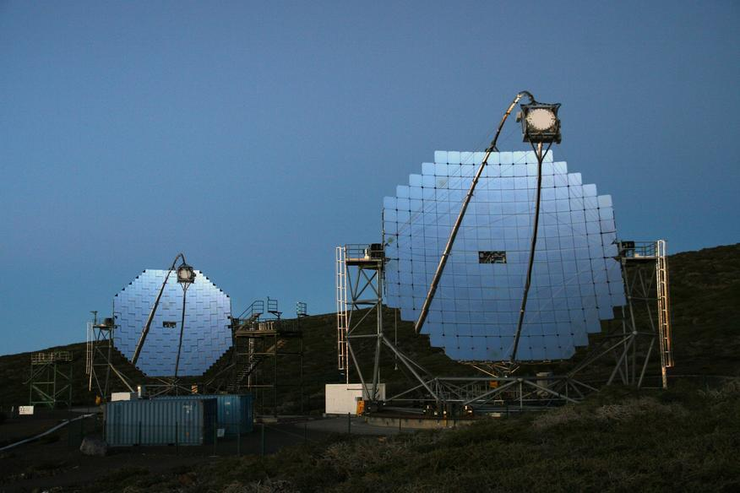
PROBLEM DEFINITION:
In this project, we tested different classifiers on "Magic Gamma Telescope" data and compared their performances. The steps for the project are:
Model Construction: Classification
Implementation & Model Evaluation
Preparing related questions & answers

Slide 3
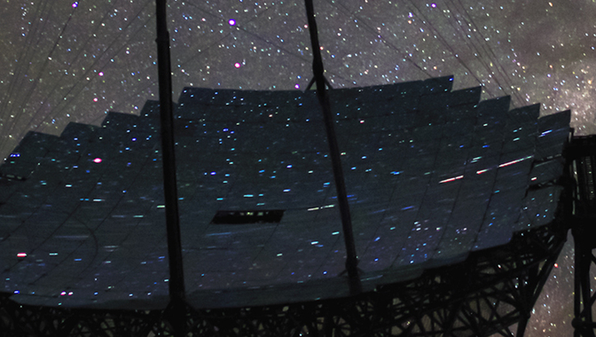
Magic Gamma Telescope Data (2007- 05 - 01)
The data is generated to simulate registration of high energy gamma particles in a ground-based atmospheric Cherenkov gamma telescope using the imaging technique. Cherenkov gamma telescope observes high energy gamma rays, taking advantage of the radiation emitted by charged particles produced inside the electromagnetic showers initiated by the gammas, and developing in the atmosphere. This Cherenkov radiation (of visible to UV wavelengths) leaks through the atmosphere and gets recorded in the detector, allowing reconstruction of the shower parameters. The available information consists of pulses left by the incoming Cherenkov photons on the photomultiplier tubes, arranged in a plane, the camera. Depending on the energy of the primary gamma, a total of few hundreds to some 10000 Cherenkov photons get collected, in patterns (called the shower image), allowing to discriminate statistically those caused by primary gammas (signal) from the images of hadronic showers initiated by cosmic rays in the upper atmosphere (background). Typically, the image of a shower after some pre-processing is an elongated cluster. Its long axis is oriented towards the camera center if the shower axis is parallel to the telescope's optical axis, i.e. if the telescope axis is directed towards a point source. A principal component analysis is performed in the camera plane, which results in a correlation axis and defines an ellipse. If the depositions were distributed as a bivariate Gaussian, this would be an equidensity ellipse. The characteristic parameters of this ellipse (often called Hillas parameters) are among the image parameters that can be used for discrimination. The energy depositions are typically asymmetric along the major axis, and this asymmetry can also be used in discrimination. There are, in addition, further discriminating characteristics, like the extent of the cluster in the image plane, or the total sum of depositions.

Slide 4
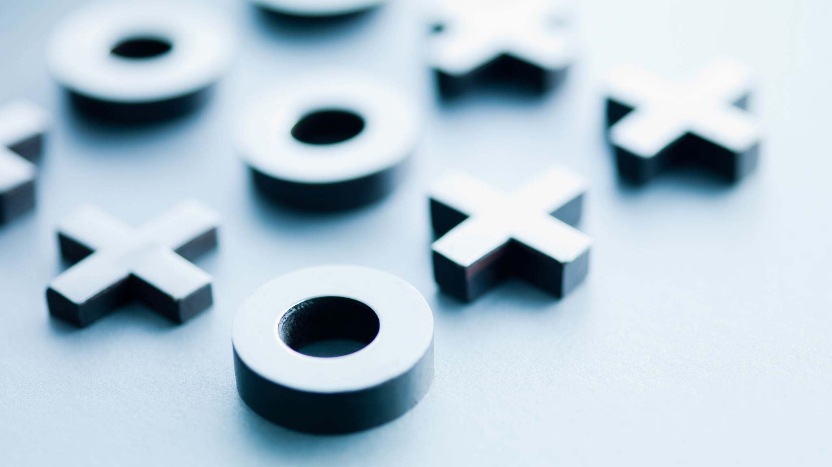
Attribute Information
1. fLength: continuous # major axis of ellipse [mm] 2. fWidth: continuous # minor axis of ellipse [mm] 3. fSize: continuous # 10-log of sum of content of all pixels [in #phot] 4. fConc: continuous # ratio of sum of two highest pixels over fSize [ratio] 5. fConc1: continuous # ratio of highest pixel over fSize [ratio] 6. fAsym: continuous # distance from highest pixel to center, projected onto major axis [mm] 7. fM3Long: continuous # 3rd root of third moment along major axis [mm] 8. fM3Trans: continuous # 3rd root of third moment along minor axis [mm] 9. fAlpha: continuous # angle of major axis with vector to origin [deg] 10. fDist: continuous # distance from origin to center of ellipse [mm] 11. class: g,h # gamma (signal), hadron (background) g = gamma (signal): 12332 h = hadron (background): 6688
So the matrix is: [19,020x11]

Slide 5
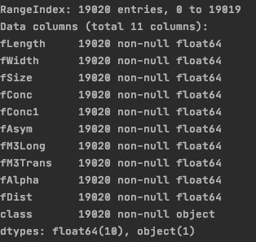
Data Pre-Processing / Cleaning
As you can see there is no missing values in our dataset.
But the type of the class is object.
So, at first, we converted it like:
1 for g and 0 for h
Number of 'g': 12332
Number of 'h': 6688
And we used fit_transform method for normalizing.
And then we splitted our data to training (%80) and testing (%20) datasets.

Slide 6
Python Implementation
We used PyCharm & Jupyter Notebook. Used libraries are : import numpy as np # ---------- used for handling numbers import pandas as pd # ---------- used for handling the dataset from sklearn.utils import shuffle from sklearn.model_selection import train_test_split # ---------- used for normalizing data from sklearn.preprocessing import StandardScaler # ---------- used for cross validation from sklearn.model_selection import KFold from sklearn.model_selection import cross_val_score, cross_val_predict from sklearn.metrics import classification_report
import time # used for performance measurement
# on below three, used for building and printing confusion matrix
import matplotlib.pyplot as plt
from sklearn.metrics import plot_confusion_matrix
import seaborn as sn
from sklearn.metrics import confusion_matrix
# ---------- used for bagging from numpy import mean from numpy import std from sklearn.model_selection import cross_val_score from sklearn.model_selection import RepeatedStratifiedKFold from sklearn.ensemble import BaggingClassifier # ---------- used for boosting from sklearn.ensemble import AdaBoostClassifier # ---------- used for decision tree from sklearn.tree import DecisionTreeClassifier # ---------- used for naive bayes from sklearn import metrics from sklearn.naive_bayes import GaussianNB # ---------- used for artificial neural network from sklearn.neural_network import MLPClassifier # ---------- used for svm from sklearn import svm

Slide 7

Implementation Details
Holdout, Bagging, Boosting methods are implied on all classifiers which are Decision Tree C., Naive Bayes C., Artificial Neural Network C., and Support Vector Machine C.
One of the classifier choosen for Cross-Validation Method (One of the Decision Trees).
For the conclusion and interpretation, confusion matrix and classfication report method (from sklearn.metrics class) are used .
These methods prints evaluation metrics like recall, accuracy, f1-score, etc.

Slide 8
COMPARING CLASSIFIERS BASED ON 3 METHODS:
HOLD OUT
BAGGING
BOOSTING

Slide 9
PROCESSING TIME / ACCURACY COMPARISION
CLASSIFIERS | Hold-out | Bagging | Boosting | Cross-Validation
DT Gain Ratio | 0.8612 seconds -0.8241- | 5.2233 seconds -0.8796- | 1.0461 seconds -0.8270- | 0.3709 seconds -0.8192-
DT Gini Index | 0.6082 seconds -0.8165- | 3.4690 seconds -0.8814- | 0.5662 seconds -0.8249- | -
Naive Bayes | 0.0256 seconds -0.7384- | 0.2375 seconds -0.7392- | 0.2930 seconds -0.6926- | -
ANN: 1 Hidden Layer | 18.3770 seconds -0.8625- | 174.0764 seconds -0.8722- | - | -
ANN: 2 Hidden Layer | 24.7068 seconds -0.8761- | 266.2587 seconds -0.8769- | - | -
Support Vector Machines | 4.9307 seconds -0.7986- | 28.2072 seconds -0.7994- | 65.9045 seconds -0.7628- | -

Slide 10
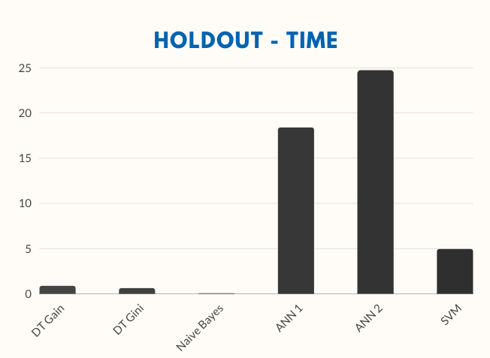
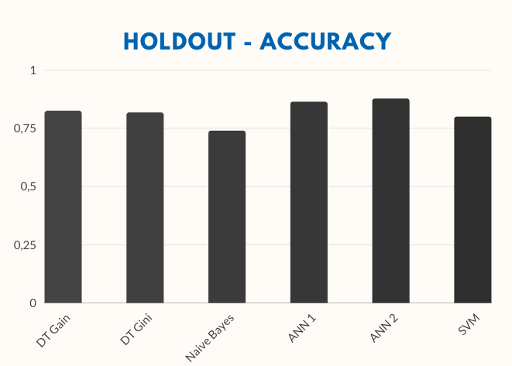
COMPARING HOLDOUT METHOD USED CLASSIFIERS
TIME: Naive Bayes < SVM < DT Gini < DT Gain < ANN 1 < ANN 2
ACCURACY: Naive Bayes < SVM < DT Gini < DT Gain < ANN 1 < ANN 2

Slide 11
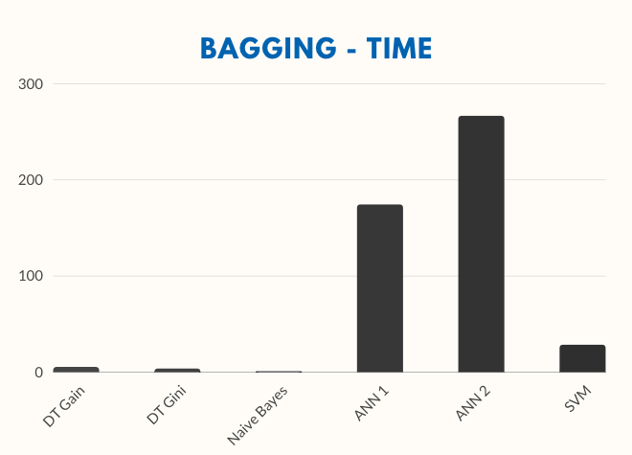
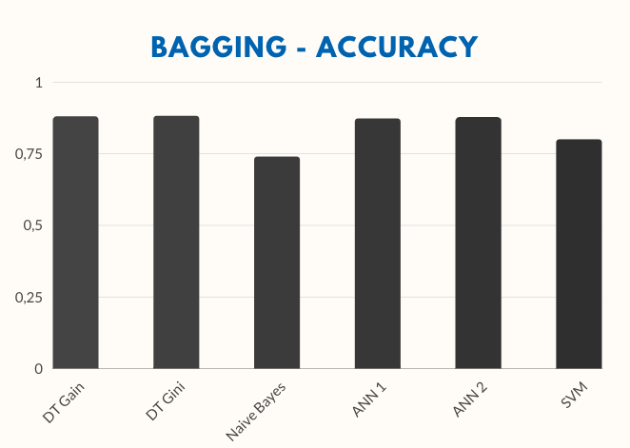
COMPARING BAGGING METHOD USED CLASSIFIERS
TIME: Naive Bayes < DT Gini < DT Gain < SVM < ANN1 < ANN2
ACCURACY: Naive Bayes < SVM < ANN 1 < ANN 2 < DT Gain < DT Gini

Slide 12
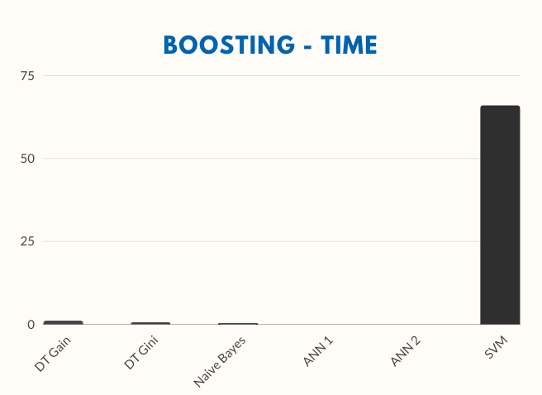
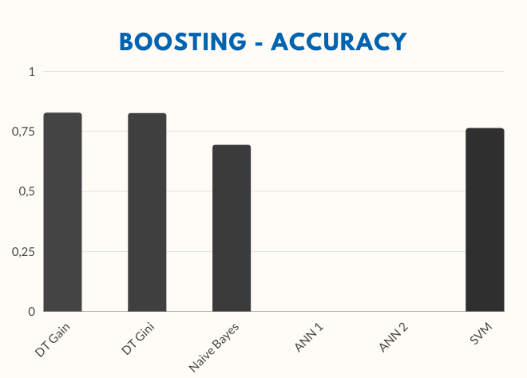
COMPARING BOOSTING METHOD USED CLASSIFIERS
TIME: Naive Bayes < DT Gini < DT Gain < SVM
ACCURACY: Naive Bayes < SVM < DT Gini < DT Gain
* It cannot be used any base estimator with AdaBoostClassifier, Only those that support a "sample_weight" fit argument are allowed (e.g., DecisionTreeClassifier).

Slide 13
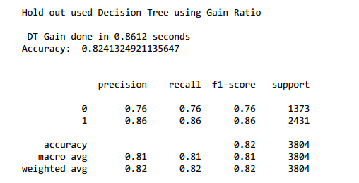
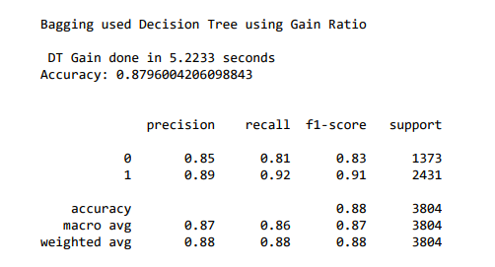
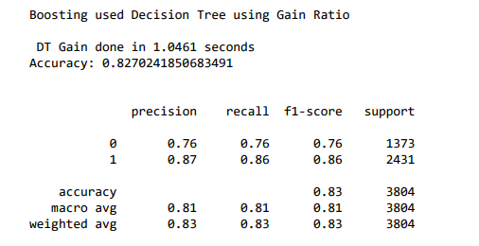
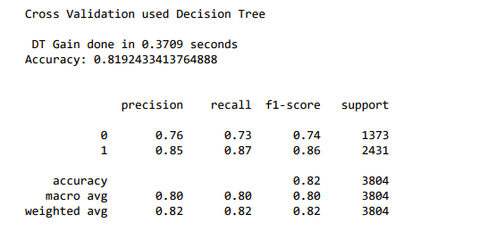
CLASSIFICATION RESULTS FOR DECISION TREE – USING GAIN RATIO

Slide 14
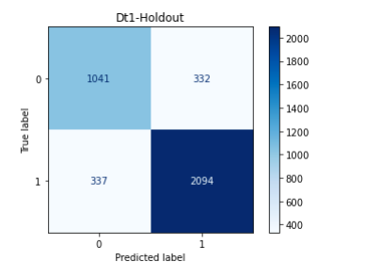
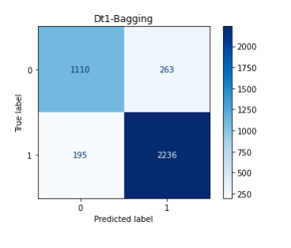
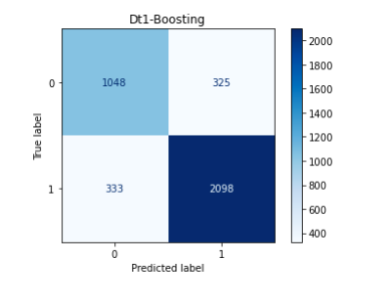
CONFUSION MATRIX FOR DECISION TREE – USING GAIN RATIO

Slide 15
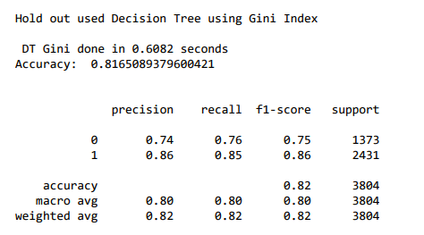
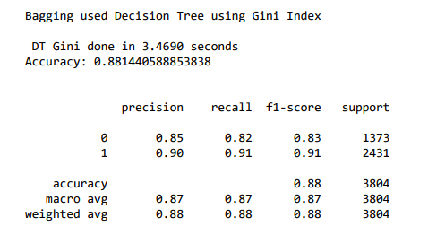
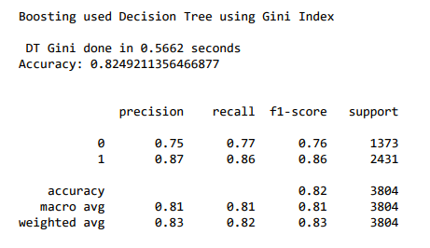
CLASSIFICATION RESULTS FOR DECISION TREE – USING GINI INDEX

Slide 16
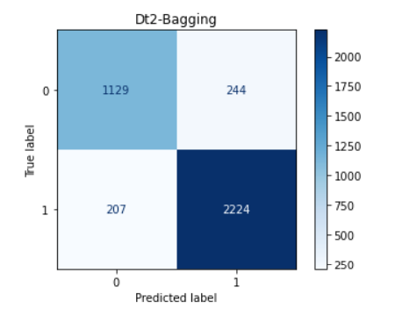
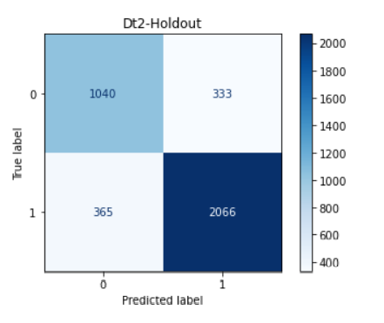
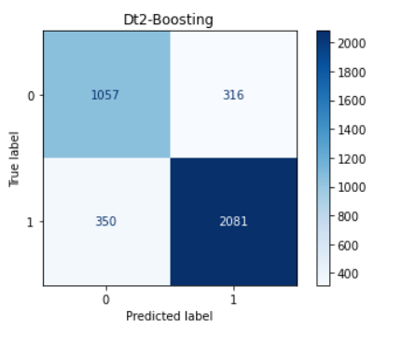
CONFUSION MATRIX FOR DECISION TREE – USING GINI INDEX

Slide 17
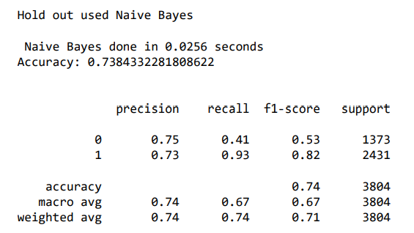
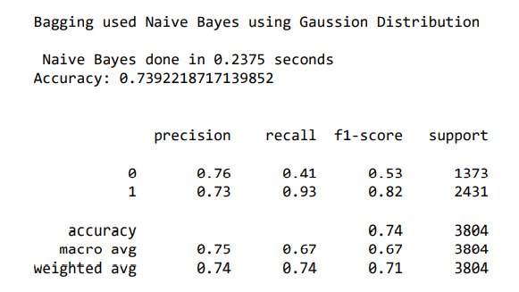
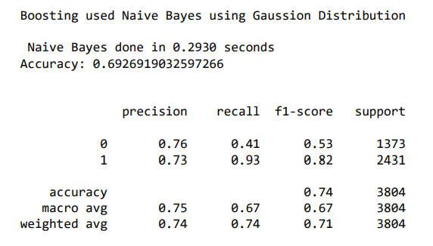
CLASSIFICATION RESULTS FOR NAIVE BAYES

Slide 18
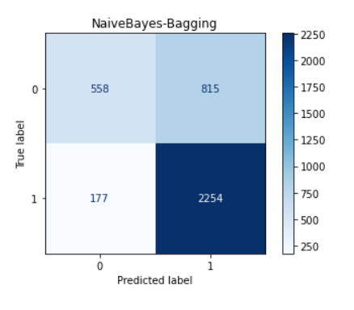
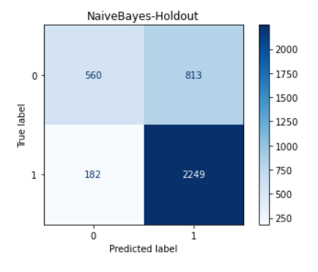
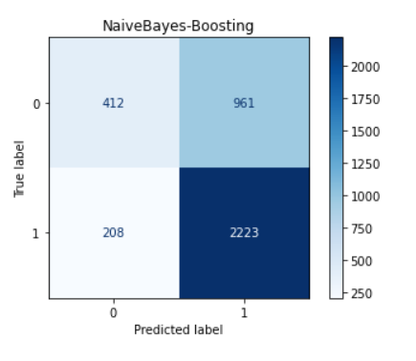
CONFUSION MATRIX FOR NAIVE BAYES

Slide 19
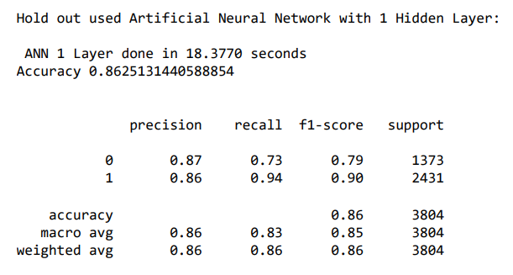
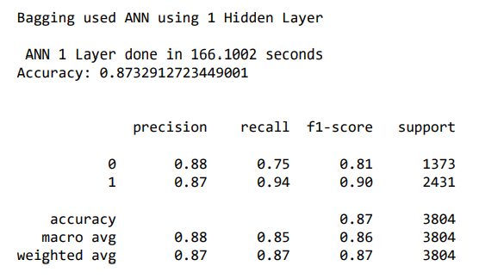
CLASSIFICATION RESULTS FOR ANN – 1 HIDDEN LAYER

Slide 20
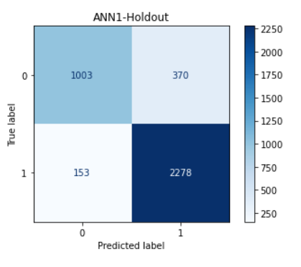
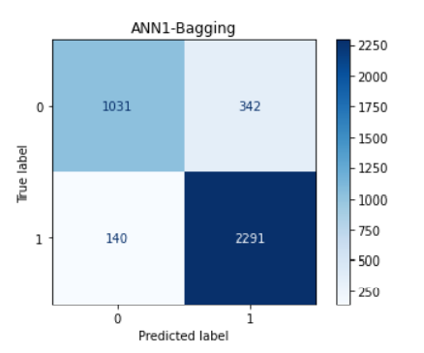
CONFUSION MATRIX FOR ANN – 1 HIDDEN LAYER

Slide 21
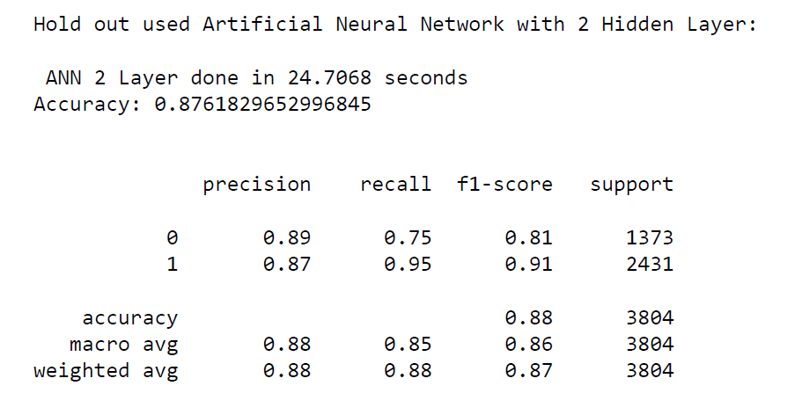
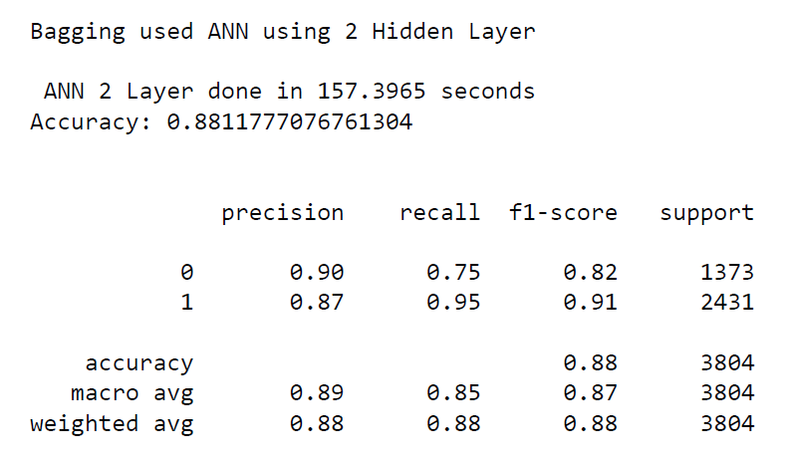
CLASSIFICATION RESULTS FOR ANN – 2 HIDDEN LAYER

Slide 22
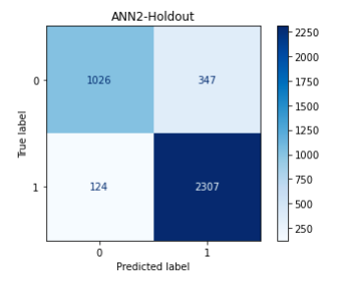
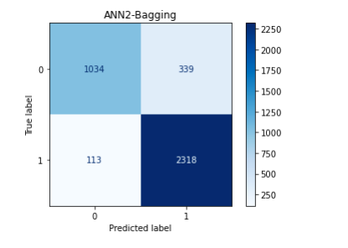
CONFUSION MATRIX FOR ANN – 2 HIDDEN LAYER

Slide 23
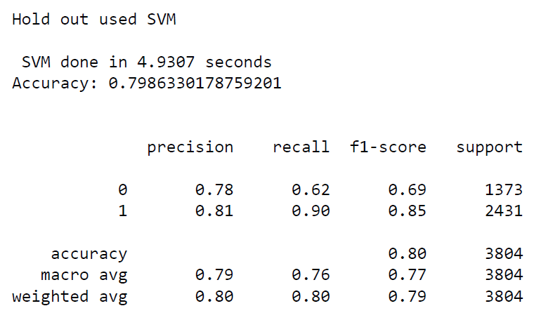
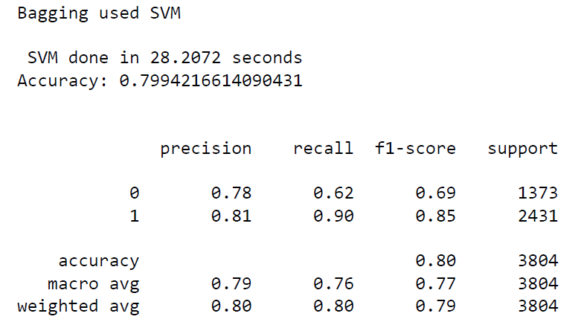
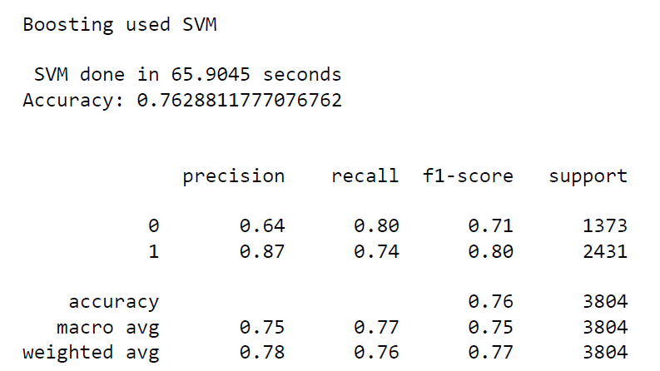
CLASSIFICATION RESULTS FOR SUPPORT VECTOR MACHINES

Slide 24
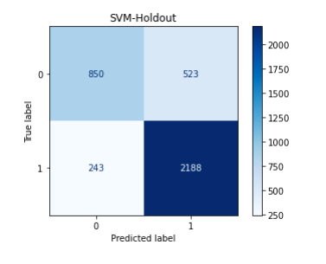
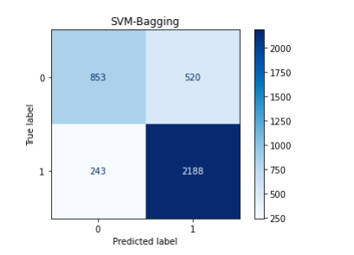
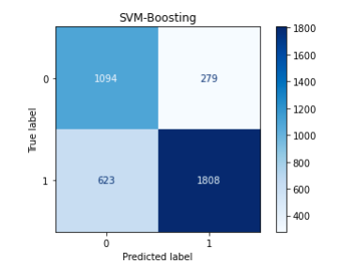
CONFUSION MATRIX FOR SUPPORT VECTOR MACHINES

Slide 25
CONCLUSION
BAGGING METHOD USED ARTIFICAL NEURAL NETWORK WITH 2 HIDDEN LAYER IS THE SLOWEST ALGORITHM
HOLD OUT METHOD USED NAIVE BAYES IS THE FASTEST ALGORITHM
BOOSTING METHOD USED NAIVE BAYES GIVES THE LEAST ACCURATE RESULTS
BAGGING METHOD USED DECISION TREE WITH GINI INDEX GIVES THE MOST ACCURATE RESULTS

Slide 26
BAGGING METHOD USED DECISION TREE WITH GINI INDEX IS THE ALGORITHM THAT GIVES THE MOST OPTIMAL RESULTS FOR OUR DATA

Slide 27
REFERENCES:
https://scikit-learn.org/stable/modules/generated/sklearn.ensemble.AdaBoostClassifier.html
https://www.datatechnotes.com/2019/03/classification-with-bagging-classifier.html
https://scikit-learn.org/stable/modules/generated/sklearn.neural_network.MLPClassifier.html
https://github.com/scikit-learn/scikit-learn/issues/1752

